Slide 1
Introduction to computing
101
Presentation by:
T.Enayatullahmansoor

Slide 2


What is CS ?
o1.
Engineering
o2.
Art
o3.
Science
o4.
Computer
o5.
Computer science

Slide 3

Big picture
This is the CORE technologies
System administration
Computer architecture
Operating system
Web engineering
DS & algorithm
Network
RDBMS
NoSQL
Machine learning

Slide 6
Abstraction
o1.
API
o2.
Super computer
o3.
Cloud computing
o4.
Container [ virtual machine]
o5.
Software testing

Slide 7
Knowledge
Declarative knowledge {What} → [Abstraction]
Imperative knowledge {How} → [Algorithm]
Some Terminologies
Program/ Software/ Application/ Script/ Shell/
Programming language [recipes]/ Coding language
Instruction/ Interpreter/ Compiler
Flow of control [working]/ Parameter/

Slide 8
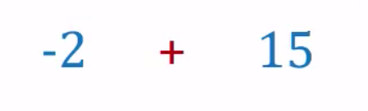
Expressions
Operators/ Operands/ Operation

Slide 9
Precedence
Operators/ Operands/ Operation

Slide 10
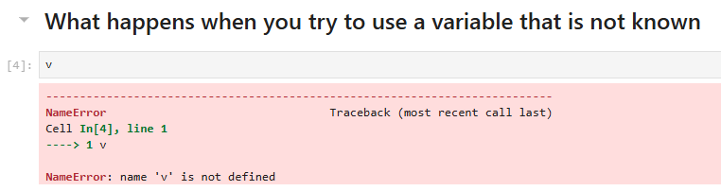
Undefined variable
Error
***Type of error***
***Error message***

Slide 11
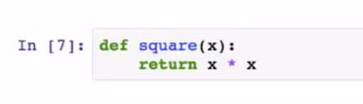

Function definitions

Slide 12
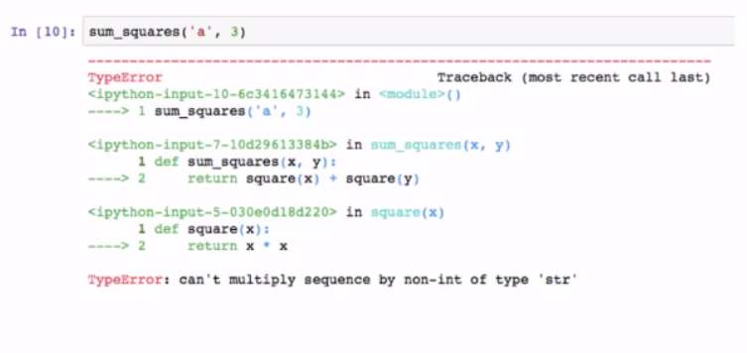
Trace

Slide 13
Designing Functions
It's important to design your functions thoughtfully. Some important point points to note:
Functions are abstractions. So, there operation should depend as little on the environment as possible.
Name should be intuitive and meaningful
Parameter should be named intuitively as well
Functions should be documented!

Slide 14
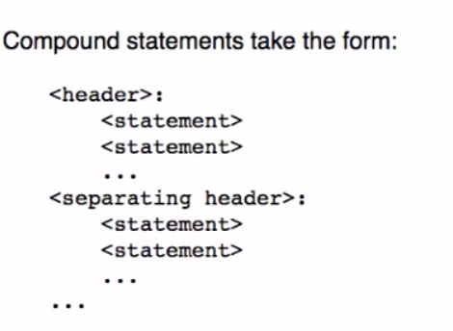
Compound Statements

Slide 15
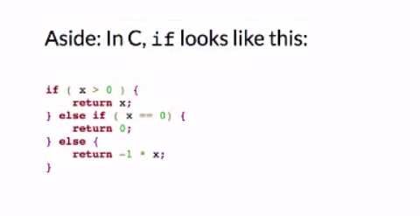
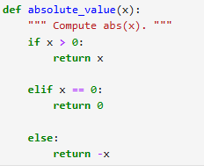
2) Conditionals
Also called branching statements. These allow you to make decisions.

Slide 16
3) Iteration, Repetition, Loops
However, that’s a lot of wastage of our time. “A good programmer is lazy programmer!”

